Slide 1
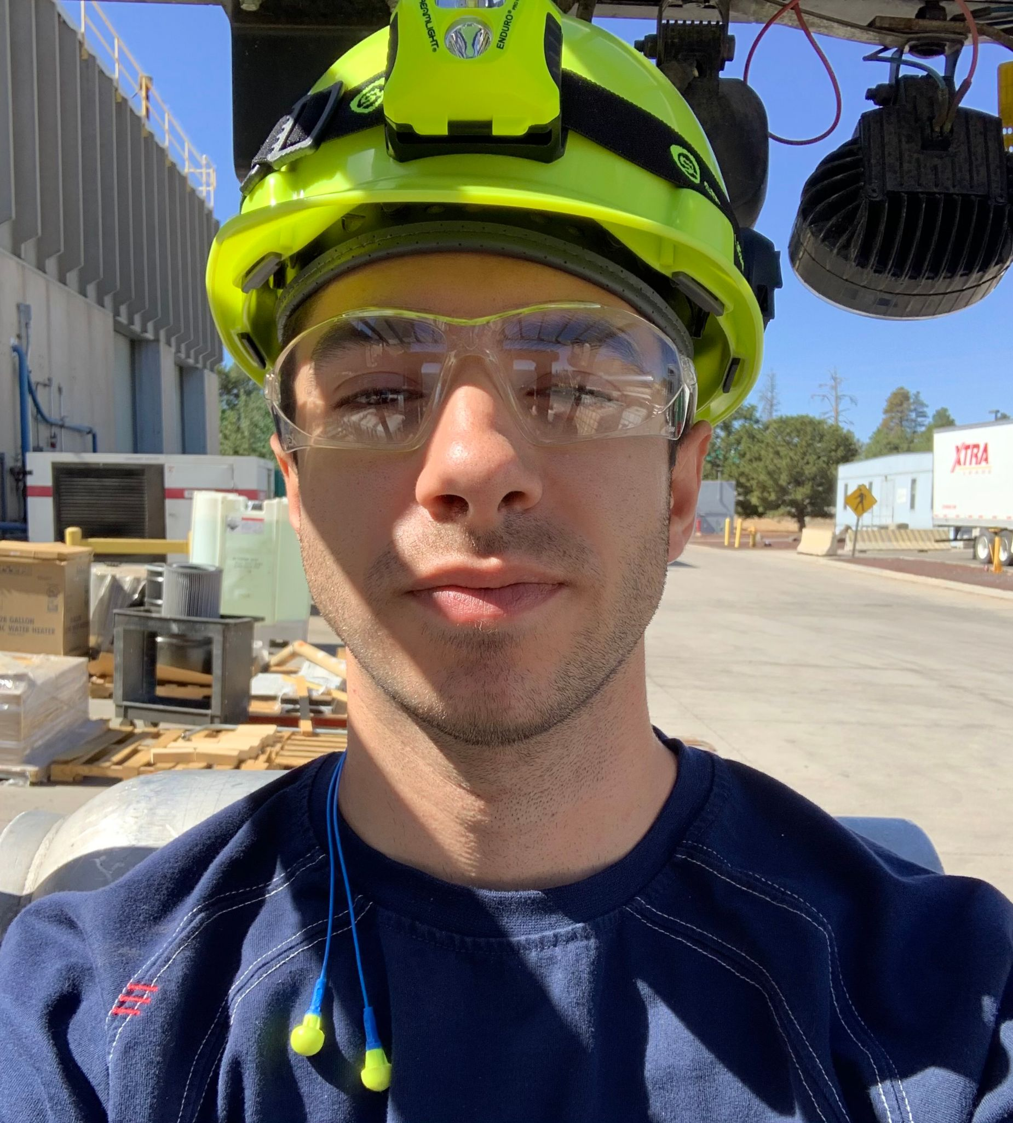
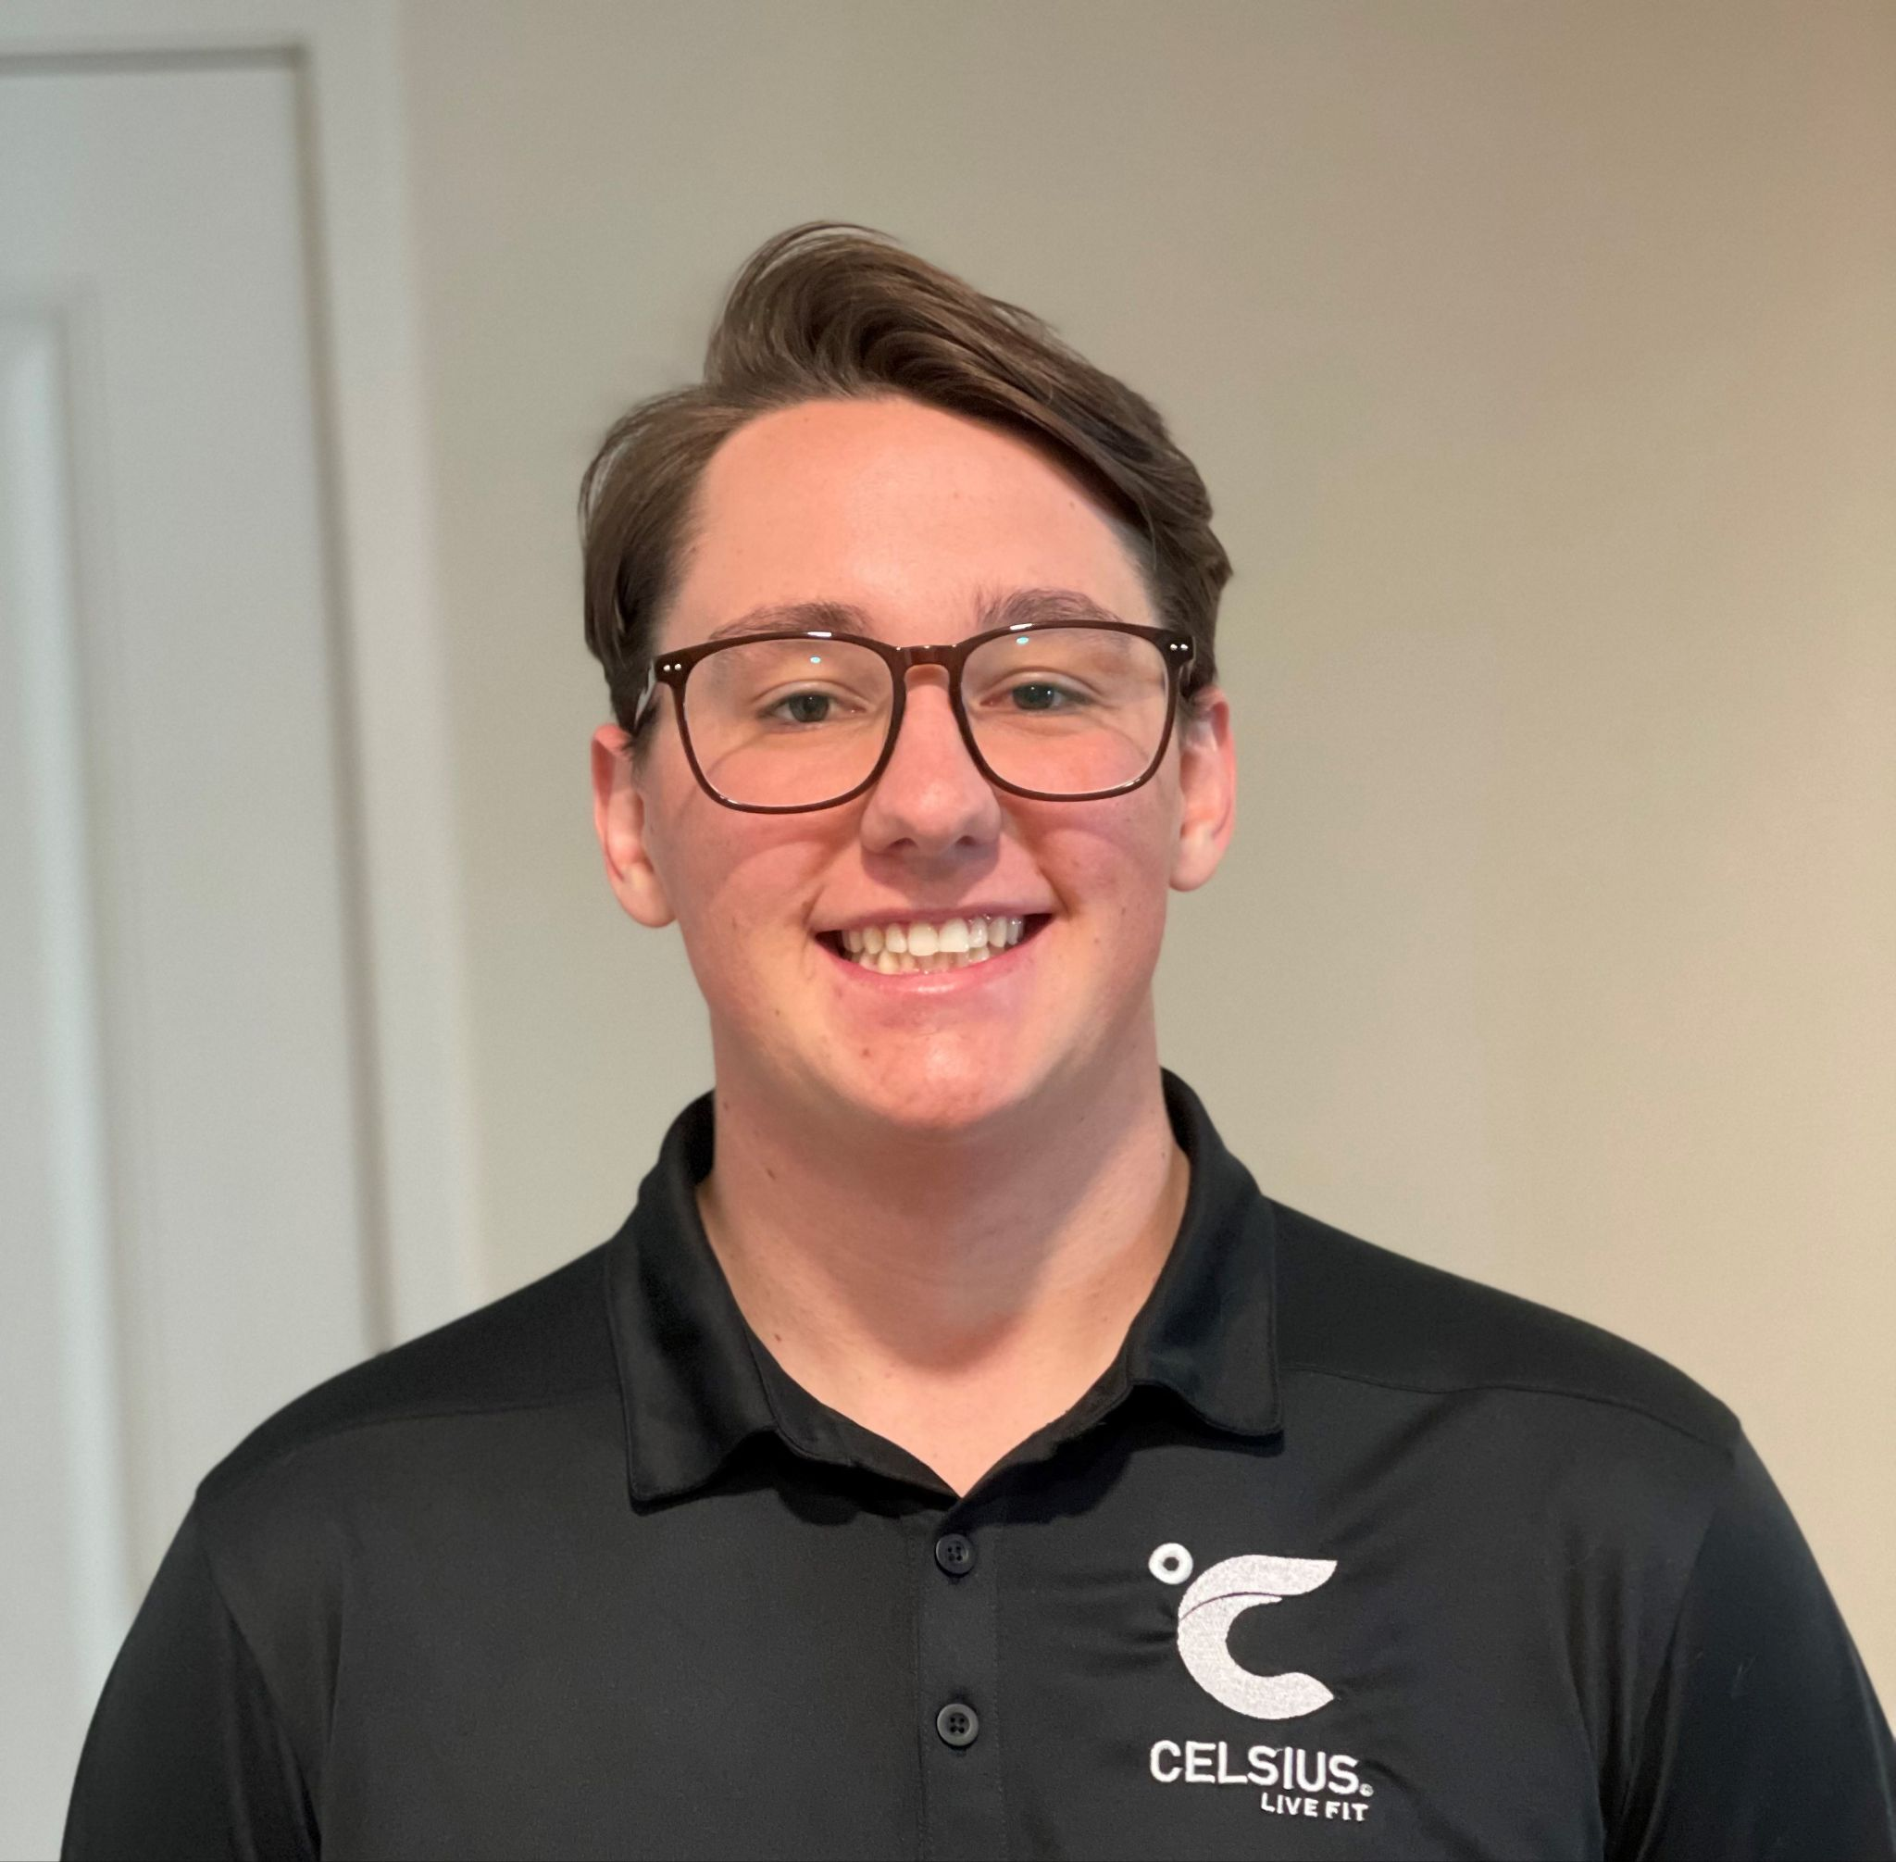
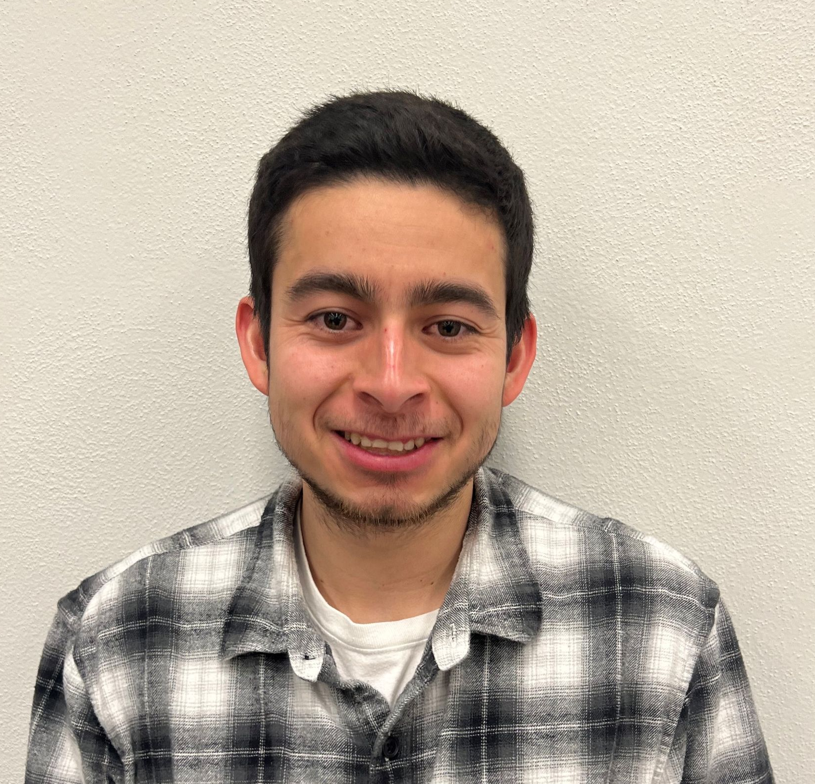
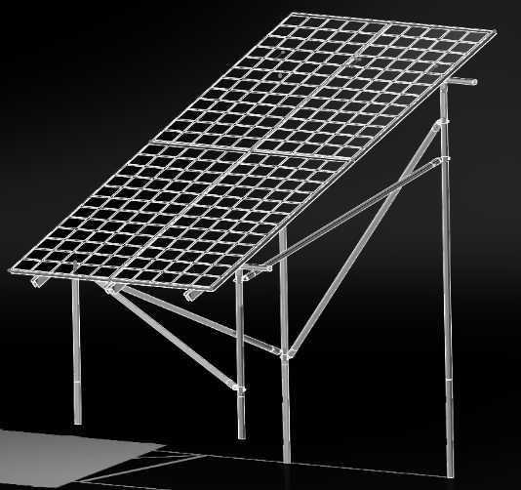
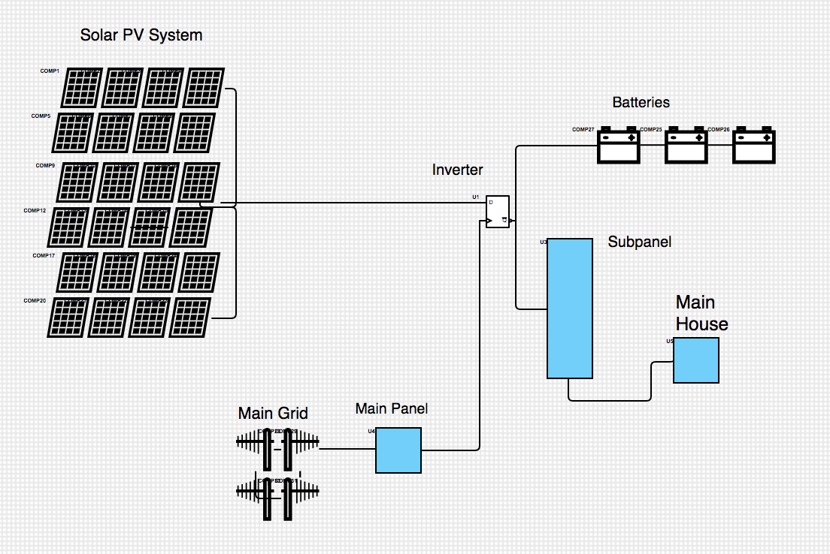
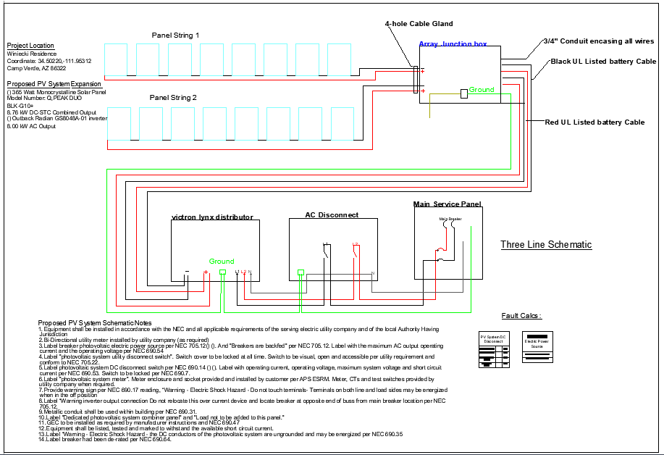
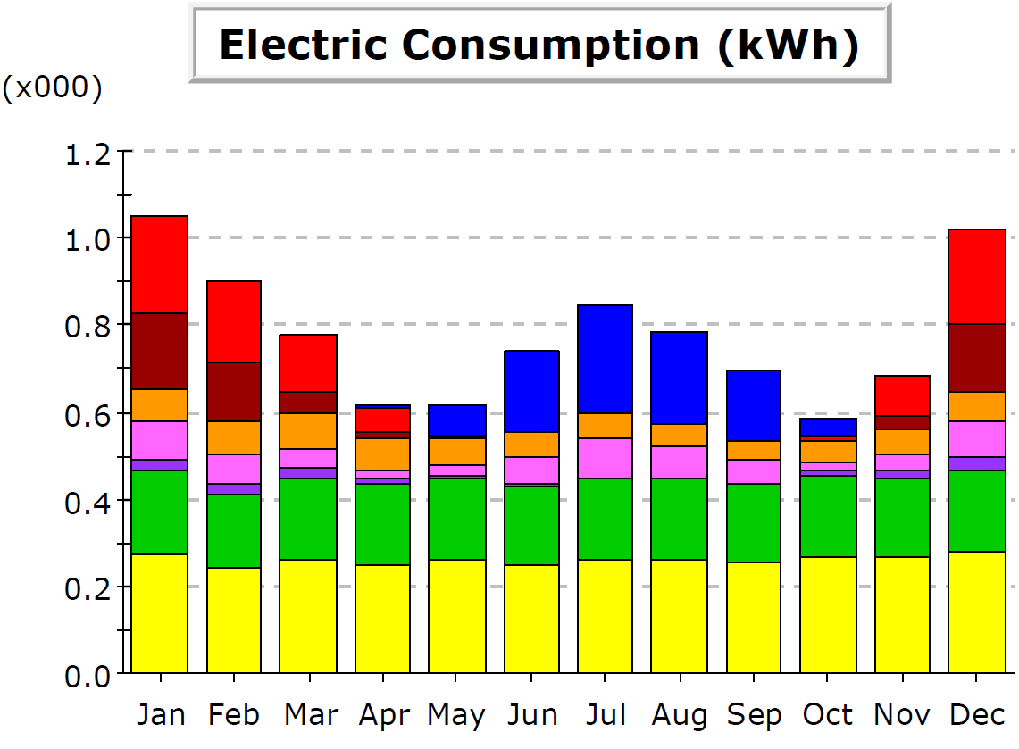
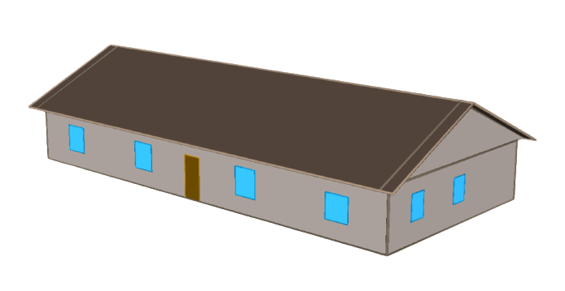
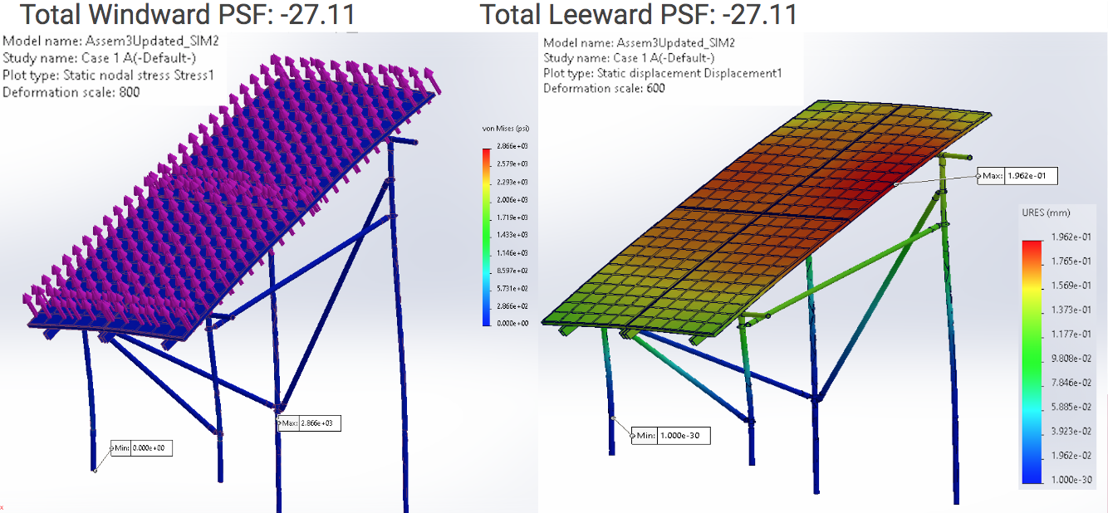
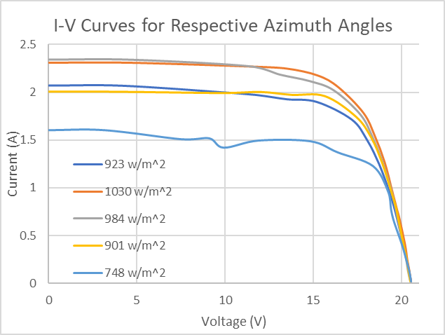
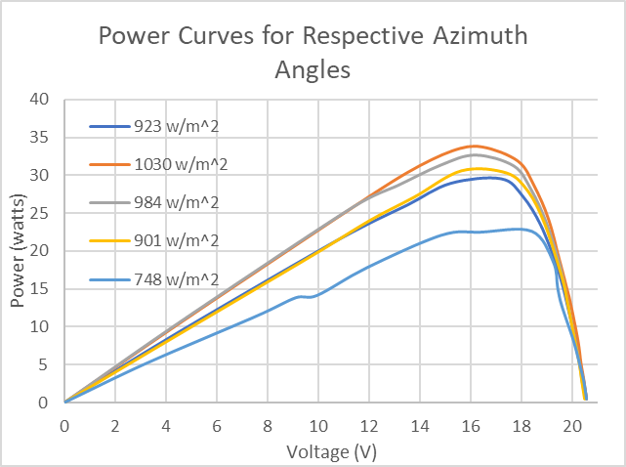
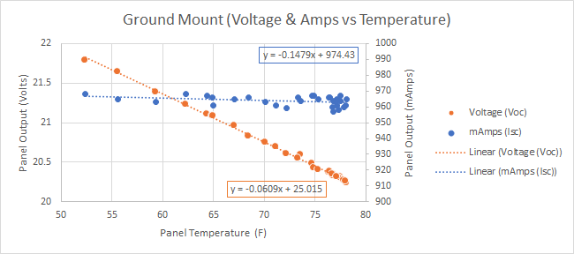
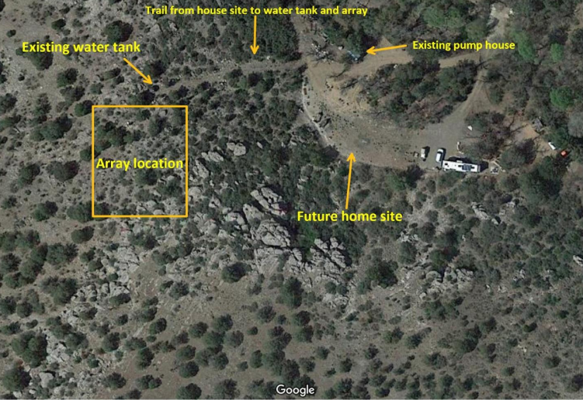
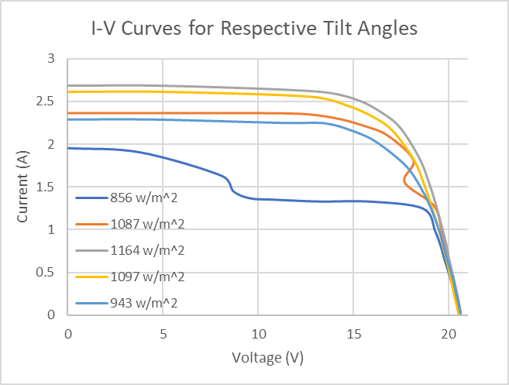
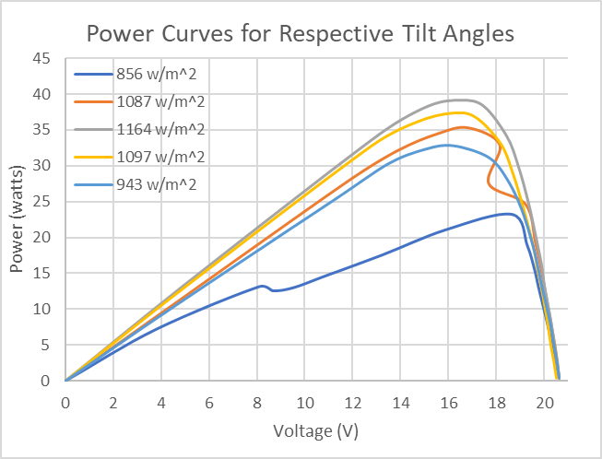
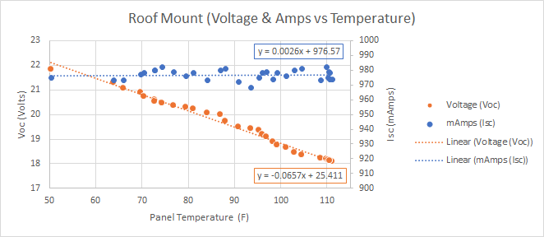
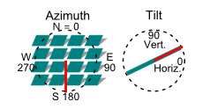
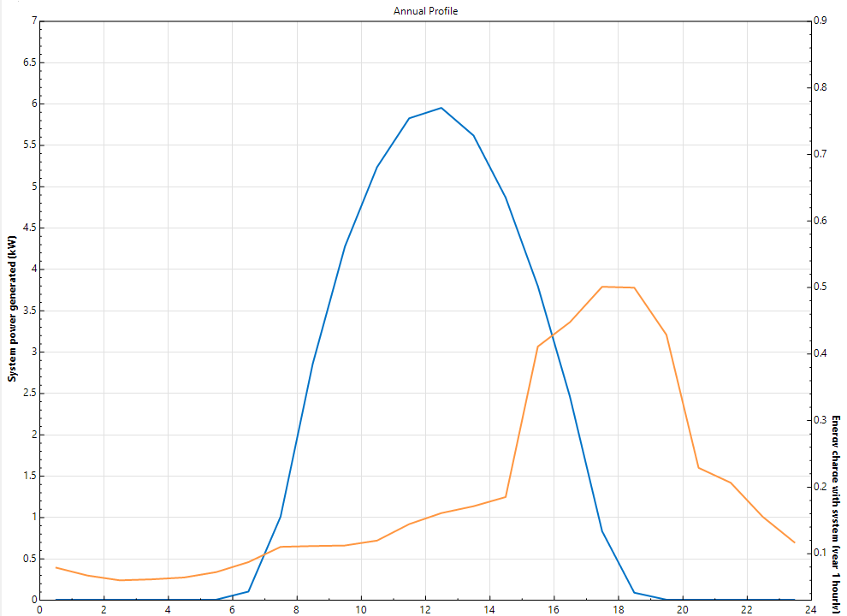
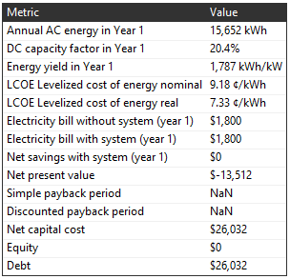
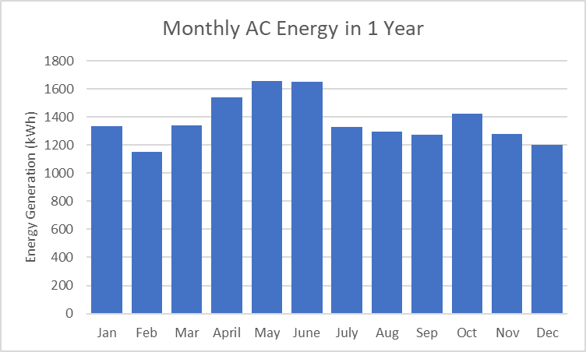
Design and Construction Planning for a Residential Hybrid Photovoltaic System
Michael Horn
Garrett Cornelius
Nicholis Santana
Issac Granados
Fall 2023 Renewable Energy Project, Northern Arizona University, Flagstaff, AZ 86011
Abstract
Results
Electrical Schematics: 1-Line and 3-Line
The objective of the Renewable Energy Team is to plan, design, and optimize an 8.8 kW, 24-panel ground-mounted hybrid photovoltaic system for residential use in Camp Verde, Arizona. The design incorporates a 18.5 kWh battery storage system and hybrid inverter capable of off grid operation. This project aims to provide self sufficient power, ensure constant energy supply, and reduce design and implementation costs. The resulting design package includes a structural analysis with FEA, optimized energy model, electrical diagram, and permitting. Overall, the project demonstrates the feasibility of economically deploying a residential scale solar array while providing a clean energy adaptation to grid source energy.
Energy Consumption: E-Quest Modeling Program
Structural Analysis: Ground Mounted PV System
Energy Generation: System Advisory Model (SAM)
[4]
Conclusion & Results
[1]
The final design results in a 8.8 kW, 24-panel ground-mounted hybrid photovoltaic system optimized for residential use in Camp Verde, Arizona
The design met all customer and engineering design requirements
The project demonstrates the feasibility of economically deploying a hybrid solar PV system for residential use
Promotes clean energy adaptation
The project enables direct implementation of the PV system
Requirements
System Budget $35,000
Meet and exceed daily energy demand
24 hrs of Emergency Battery Storage
Optimize Panel Efficiency
Grid-Tied Hybrid Capability
Testing and Analysis
[2]
Annual Profile
Methods
System Power Generated (kW)
Energy Charge with System (year 1 hourly)
References
Emulating a professional solar design, the team’s approach ensures a comprehensive design package:
Energy Model to Define System Scale
Project Costing and Bill of Materials
Optimize angle and azimuth setting
Structural Analysis
Electrical Mapping and Component Diagrams
Standardized Building Permits
[1] J. Hirsch, “eQUEST the QUick Energy Simulation Tool,” EQUEST, https://www.doe2.com/equest/
[2] https://help.solidworks.com/2021/english/SolidWorks/cworks/c_Simulation_Studies_2.htm
[3] System Advisor Model Version 2022.11.29 (SAM 2022.11.21) https://https://sam.nrel.gov
[4] https://www.autodesk.com/solutions/electrical-design
Acknowledgements
The team would like to acknowledge the support, guidance and contributions from faculty Dr. David Willy and Dr. Carson Pete. This project was inspired by Steve Winiecki, owner of the Camp Verde property and customer for the project design and construction package.
[3]

